Slide 1



Blockchain

Slide 2
FIRST OF ALL

Slide 3


Slide 4




Slide 5
How to create an impenetrable database?
Notes:
Speak about what makes the databases penetrable
Centralized point of failure
Can be compromised easily
The data inside the database is not encrypted except passwords
One person has all the control

Slide 6
What is a blockchain?
Notes:
A blockchain is a continuously growing list of records, called blocks which are linked together and secured using cryptography.
That’s the standard book definition, you don’t need to learn it just understand the concept:
Genesis Block
Data:
Data
Previous Hash
Hash
Genesis block has previous hash as its the first and this block stays till the blockchain ends or is deleted.
Next block

Slide 7
What will it take?
Hash
Immutable Ledger
Distributed P2P Network
Mining mechanism
Consensus Protocol

Slide 8
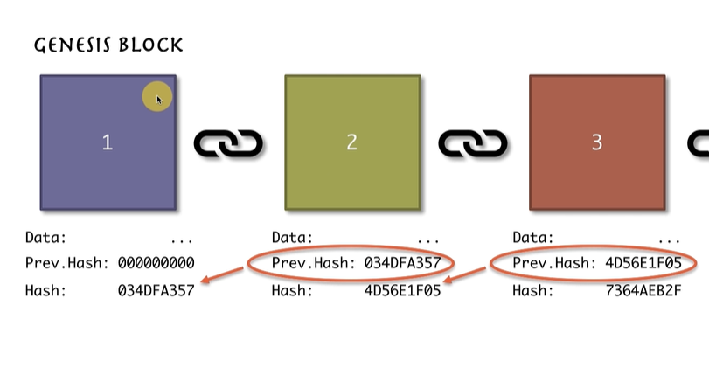

Slide 9
Hash
SHA 256
Notes:
What if we could give a single identity to every known document in the world everything that we have documents, videos, PPTs imagine we could give every software a name or an identity that was singular to that very document.
Such technology does exist and it’s called SHA256 ( Secure hash algorithm 256 )
Take up 256 bits and is of 64 characters
Each character is a Hexadecimal number 16 possible numbers ( 0-9, A-F )

Slide 10
Immutable Ledger
Notes:
Give example of properties and owner records.

Slide 12
Distributed P2P Ledger
Notes:
Now let’s assume that one guy has the computing and financial power to change the whole ledger from one point and changes it till the end and every property from that point is changed or tampered with. How do we fix that ?

Slide 13
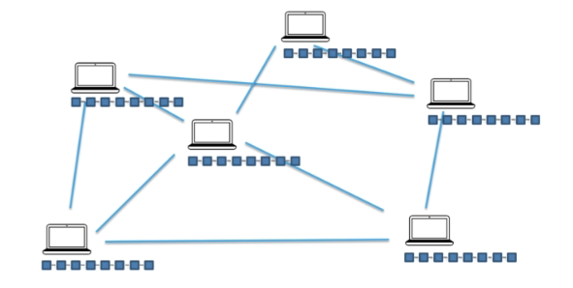

Slide 14
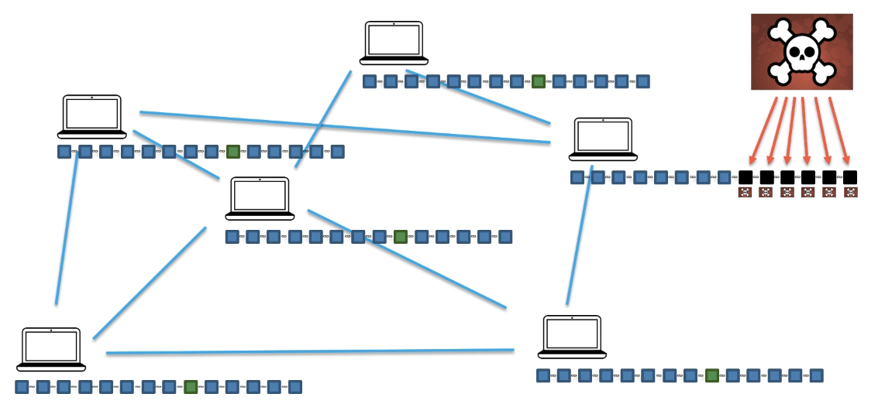
Notes:
Now let’s say that someone from the chain decides to change the data and because the data is linked every block after the tampered block is changed.

Slide 15
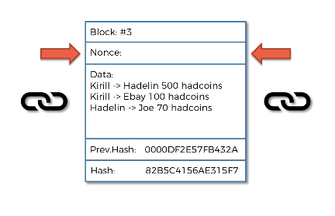
Mining
Notes:
So what is mining? You guys must have heard about people setting up rigs and computers to mine bitcoin and earn money from that. How does that happen? Now let’s a look at the block that we have in front of us, do you guys notice anything new in the block? This field is known as the nonce, now why is there a need for the nonce?
Nonce is used

Slide 16
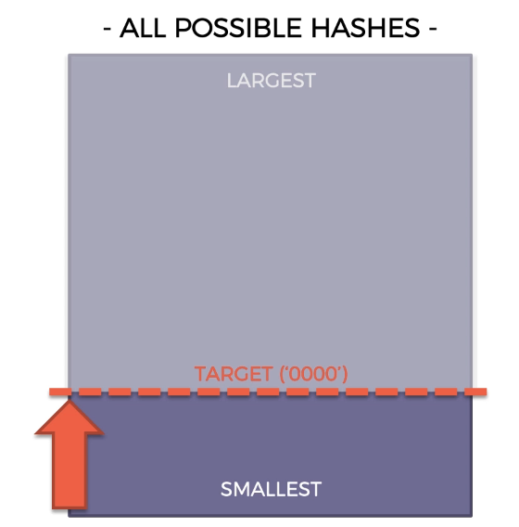
How mining works?
Changing the nonce using hit and trial, in order to generate a hash below the target.
This nonce is then used to mine the block and is added to the chain.

Slide 17


Slide 18
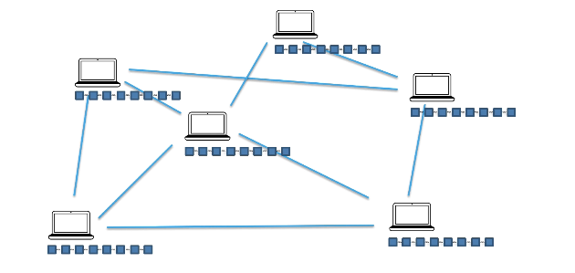
Consensus Protocol

Slide 19
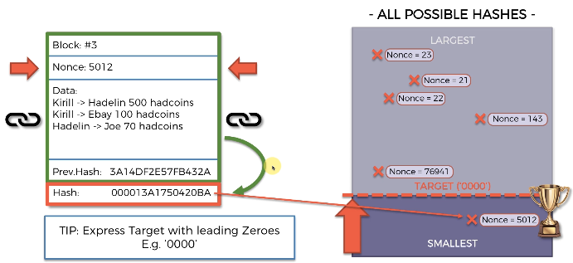
Challenge 1: Attacker

Slide 20
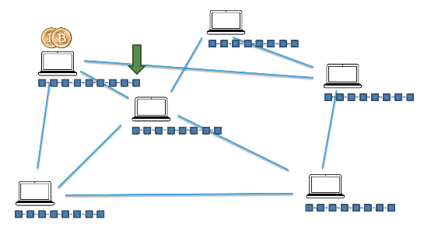
Challenge 1: Attacker

Slide 21
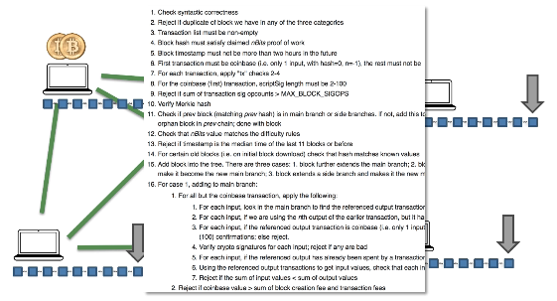
Challenge 1: Attacker

Slide 22
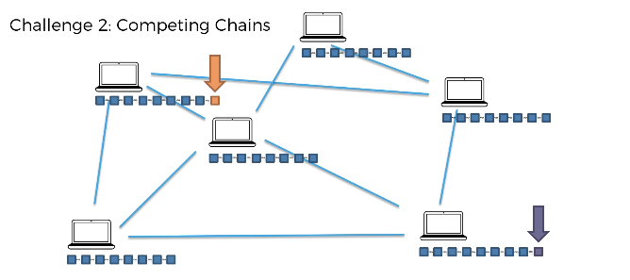
Challenge 2 : Competing Chains

Slide 23
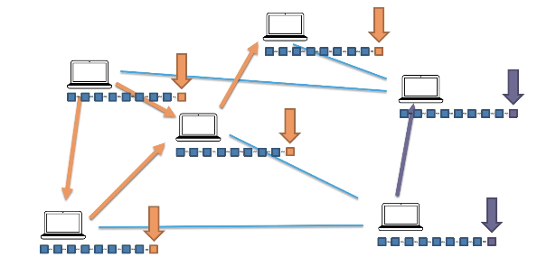
Challenge 2 : Competing Chains

Slide 24
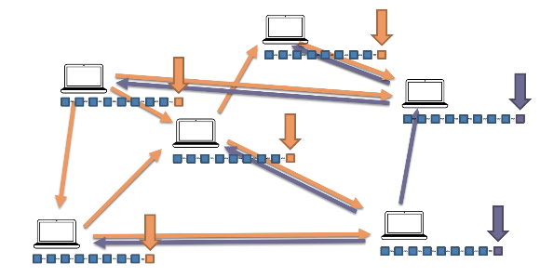
Longest Chain Wins

Slide 25
Longest Chain Wins

Slide 26
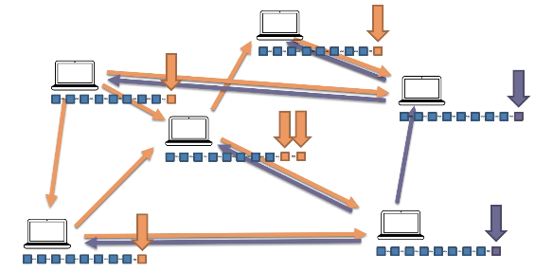
Longest Chain Wins

Slide 27
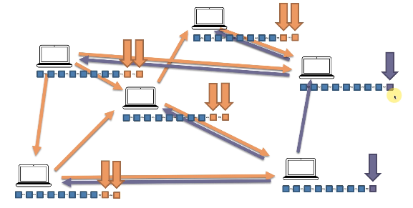
Longest Chain Wins

Slide 28
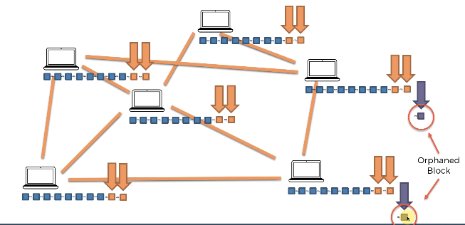
Longest Chain Wins

Slide 29


Slide 30
Theory : DONE!!!

Slide 31


